Slide 1
University of Florida Academic Activities Reporting (AAR)

Slide 2
Academic Activities Reporting(AAR) AAR Overview
Academic Activities Reporting (AAR) is the process used to identify faculty who are teaching students and to record the contact hours associated with the instruction
Why AAR?
Require by the State of Florida (Florida Board of Governor )
12 Hours Law Requirement (1012.945 Fla.stat ) – Maximum contact hours
Instruction and Research (IRD) submission
Require by the Federal Government through Effort reporting
Other Regulatory submissions
Use for faculty Tenure and Promotion
Use for University Decision Making

Slide 3
AAR System Inputs and Outputs
_{Graduate Course Info}
_{Dept Graduate Administrators}
_{Student Info}
_{Committees}
Graduate Information Management System (GIMS)
_{Coordination}
_{Dept AAR Coordinator}
_{Instructors}
_{Room Assignment}
_{Effort System}
_{Department}
_{Contact Hours}
_{Dept Academic Staff}
_{Course Scheduling}
_{Section File (Registrar)}
Academic Activities Reporting System (AAR)
_{Coordination}
Board of Governors Reporting (SIF, IRD, Expenditure Analysis)
_{HR / Payroll Data}
_{Job Data}
Dept HR/Payroll Administrators
_{HR / Payroll System}

Slide 4
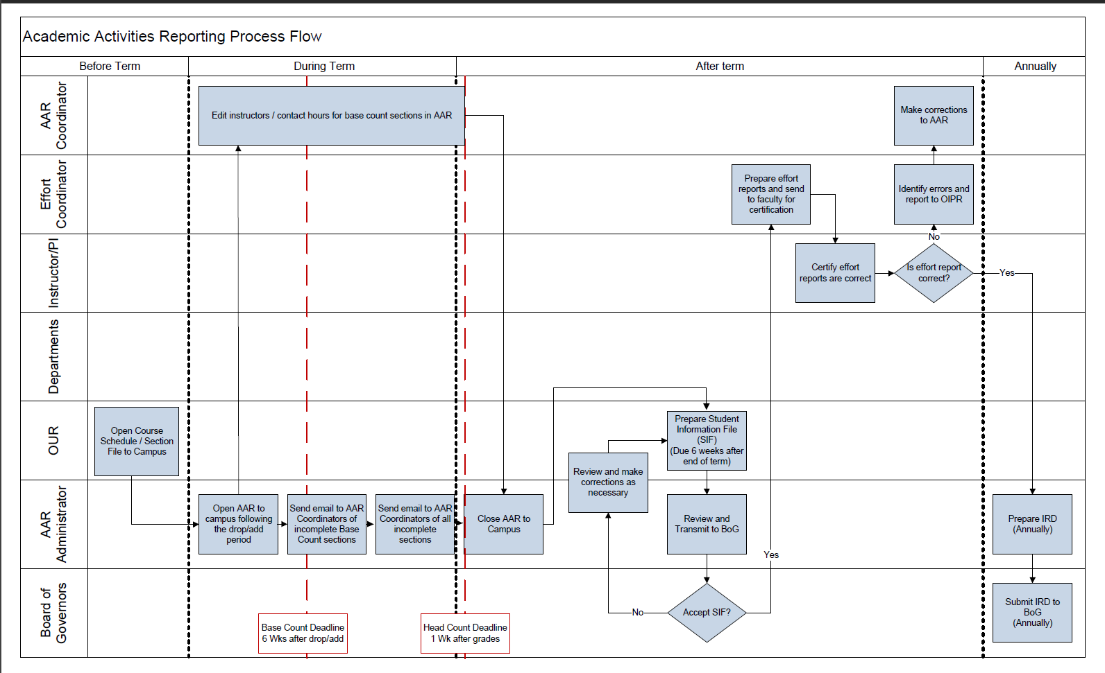
AAR Reporting Process Flow

Slide 5
Academic Activities Reporting(AAR) AAR
Things to know as a Coordinators:
1. Difference between Headcount and Base count
Base count sections are sections for which the contact hours for the course are a result of the number of periods the section meets. Contact hours are not affected by enrollment. Generally, base count sections have a fixed meeting time and place.
Head count sections are sections for which the contact hours for the course are a result of the number of students enrolled. Head count sections are not required to have a fixed meeting time and place, and consequently the number of periods the section meets (if any) does not affect the number of contact hours given to the section.

Slide 6
Academic Activities Reporting(AAR) AAR
Things to know as a Coordinators:
2. Contact Hours as calculated as Follow:
If course is only “base contact hour” then contact total = calculated base contact hour
If course is only “head count”, then contact total = calculated head count hour * paying enrollment
If both base contact and head count are associated with the course then contact total = (head count * paying enrollment) + base contact (this calculation only applies to courses that do not share a meeting time with other courses)
The maximum number of contact hours that can be given to an instructor is 12.

Slide 7
Academic Activities Reporting(AAR) AAR
Things to know as a Coordinators:
3. Thesis section:
Committee Chairs and Co-Chairs will be labeled “Chair” in the “Role” field and are assigned full head count value for every committee they serve on as a chair or co-chair.
Committee Members will be labeled as “Member” in the “Role” field and are assigned 1/3 head count for every committee they serve on as a member.
Because of this, the Total Contact Hours assigned for the section may be higher than the section contact total. However, this is allowable for thesis sections and will not cause an alert in the system.
Courtesy Appointment can’t be used to assign contact hours

Slide 8
Academic Activities Reporting(AAR) AAR
Things to know as a Coordinators:
4. Always mark the section complete:
When not mark complete, contact hours and instructors are not pick up in reports submitted to the Federal and the State.
You can find all your sections incomplete by navigating to
MyUfl menu > Academic Activities Reporting > AAR Report
5. If you think the total contact hours is not correct for a course or section, please reach out to us : UF-AAR-ADMIN@aa.ufl.edu
6. Our Website has more information
(https://ir.aa.ufl.edu/academic-support/academic-activities-reporting/)

Slide 9
Academic Activities Reporting(AAR) AAR
QUESTIONS?
HELP WITH ISSUES?

